Slide 1
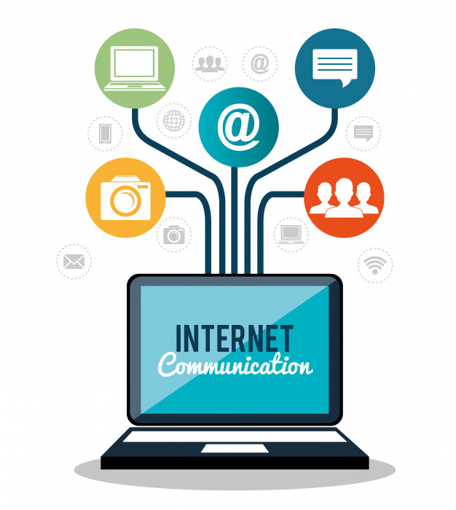
How does the web work ?

Slide 2
How does the web work?
When you input the address of a website for example (gomycode.ng),
The browser goes to the DNS server, and finds the real address of the server that the website lives on.
The browser sends an HTTP request message to the server, asking it to send a copy of the website to the client. This message, and all other data sent between the client and the server, is sent across your internet connection using TCP/IP, Ones the server approves the request which means you are allowed to have look, The browser assembles the data packets into a complete web page and displays it to you.

Slide 3
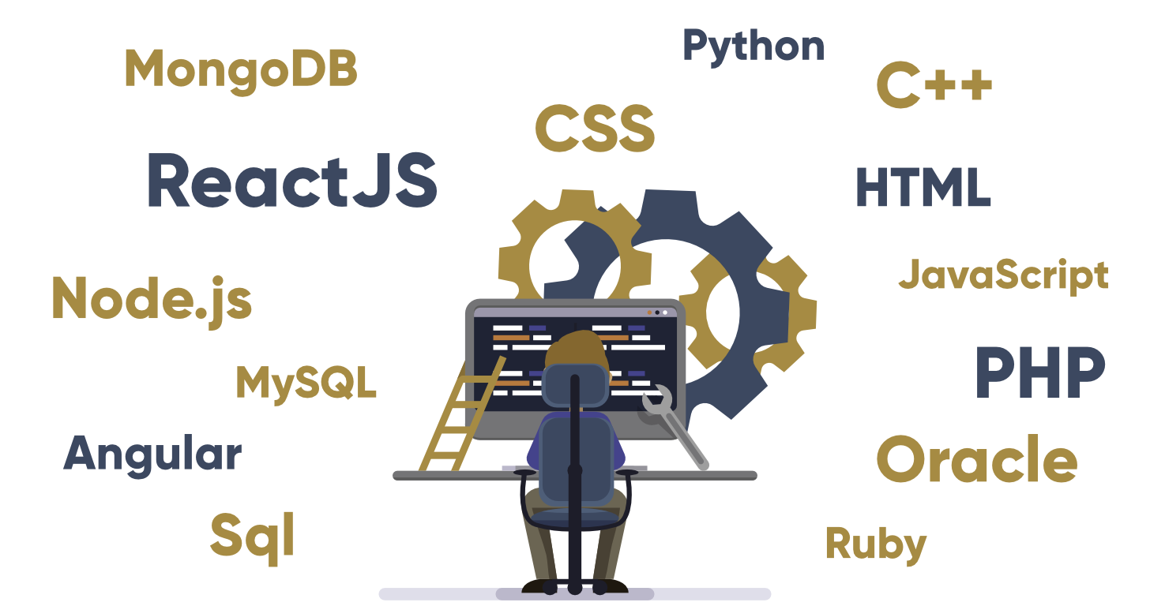
What do you need to be a web developer ?

Slide 4
What do you need to be a web developer?
To become a Web Developer, you should have an understanding of HTML, CSS, and JavaScript. It’s also recommended to learn about CSS and CSS frameworks. Developing these fundamental web development skills will give you the foundation and logic for communicating with programming languages.
1. Learn Web Development Fundamentals
2. Choose a Development Specialization
3. Learn Key Programming Languages for Web Development
4. Build Projects to Develop Your Web Developer Skills
5. Build a Web Development Portfolio

Slide 5
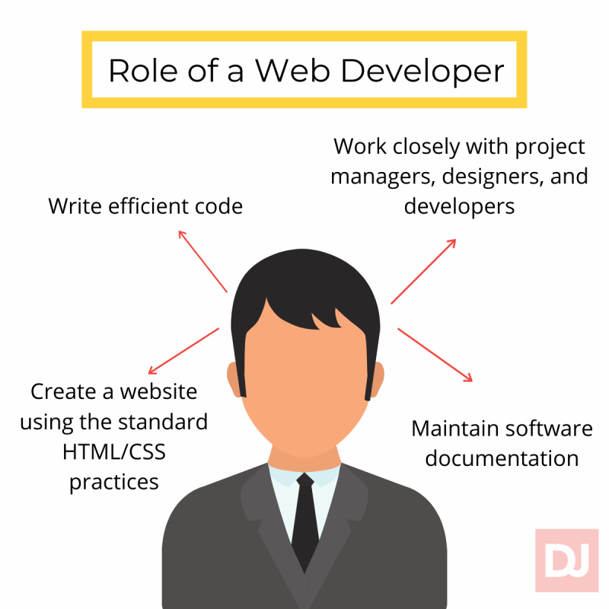
What is the role of a web developer?
The role is responsible for designing, coding and modifying websites, from layout to function and according to a client's specifications. Strive to create visually appealing sites that feature user-friendly design and clear navigation.

